Slide 1

SRI VENKATESWARA COLLEGE OF ENGINEERING AND TECHNOLOGY
DEPARTMENT OF
ELECTRONICS AND COMMUNICATION ENGINEERING
PROJECT TITLE:DESIGN AND ANALYSIS OF DIFFERENT ADDERS USING REVERSIBLE LOGIC GATES
TEAM GUIDE: Mr. S.NAGARAJ
BATCH:A8
E.NIKITHA (21781A0459)
G.HEMA SUNDAR REDDY (21781A0463)
G.VINAY (21781A0466)
I.VEERA MANOHAR REDDY (21781A0481)
J.MAHESWARA REDDY (21781A0482)

Slide 2
Contents:
Abstract
Introduction of the Project
Literature review
Existing system of the Project
Draw backs in the existing system
Proposed Methodology
Advantages of the proposed model
Required Tools
Result
Partial output
References

Slide 3
Abstract:
The design and analysis of efficient adders are crucial for enhancing the performance of digital systems, particularly in arithmetic and signal processing applications. This implementation presents the comparison of five different types of adders Ripple Carry Adder (RCA), Carry Increment Adder (CIA),Carry Skip Adder(CSKA),Carry Select Adder (CSLA), and Carry Save Adder (CSA) using Basic logic gates and Reversible logic gates. Reversible logic is an emerging computational model that offers reduced power dissipation, which is a significant advantage in low-power digital circuit design. Each adder type is analyzed in terms of its logical structure, delay, area, and power consumption, with the aim of identifying how reversible gates can optimize these parameters. The implementation of basic reversible gates such as the Toffoli gate, Peres gate and Feynman gate in constructing the adders and compares their performance with traditional basic adders.

Slide 4
Introduction of the project:
1. Fundamentals of Adders:
Adders are key components in digital electronics, used for binary addition.
They are essential in various applications like arithmetic logic units (ALUs), processors, and digital signal processing.
2. Importance of Adder Optimization:
The design of efficient adders is crucial for improving the speed and efficiency of computations in digital systems.
Optimizing adders leads to better performance in modern digital circuits.
3. Introduction to Reversible Computing:
Reversible computing has become a significant area of research due to its potential to reduce power consumption.
Reversible gates, unlike traditional gates, do not dissipate energy during computation, making them useful for low-power designs.

Slide 5
4. Role of Reversible Gates:
Reversible gates have a one-to-one mapping between inputs and outputs, which prevents energy loss.
These gates are fundamental in achieving power-efficient digital systems and are a promising solution in quantum computing and energy-efficient devices
5. Project Objective:
The project focuses on designing and analyzing various binary adders (half adders, full adders, multi-bit adders) using reversible gates.
The goal is to develop adders that are more energy-efficient while maintaining performance.
6. Gates to be Explored:
Different reversible gates like the Feyman gate, Toffoli gate, and Peres gate will be explored for designing adders.

Slide 6
7. Performance Evaluation:
The performance of these adders will be evaluated based on key parameters: area, delay, and power consumption.
A comparison between traditional adders and reversible adder designs will highlight the benefits and limitations of using reversible gates.
8. Significance of the Project:
The project aims to contribute to the development of efficient, low-power adders, which are essential for energy-sensitive systems like mobile devices, embedded systems, and quantum computers.

Slide 7
Literature Review:
1. Reversible Logic Gates and Their Importance:
Reversible logic gates, introduced in the 1970s by R. Landauer and C. Bennett, have gained attention due to their potential for low-power design in digital circuits. Traditional irreversible gates dissipate heat and energy due to the loss of information, while reversible gates do not, as they preserve all input information in the output.
The primary benefit of reversible gates is their ability to minimize power consumption, making them essential in modern low-power devices and quantum computing (Bennett, 1973).
2 .Types of Reversible Gates:
Several reversible gates have been proposed, such as the Feyman Gate, Toffoli Gate, and Peres Gate, each with unique characteristics and potential applications:
Feyman Gate:The first input qubit is copied to the first output qubit, while the second output qubit is the XOR of the two input qubits. . It is widely used due to its universality (Feyman & Toffoli, 1982).
Toffoli Gate: A 3-input gate that is reversible and can perform logical operations like AND, OR, and NOT. It is often considered a universal gate in reversible computing (Toffoli, 1980).
Peres Gate: A 4-input reversible gate used for building more complex circuits efficiently (Peres, 1985).

Slide 8
3. Adders in Digital Systems:
Adders are fundamental to arithmetic operations and are used in processors, ALUs, and digital signal processors. The most basic adders are half adders and full adders, which combine binary numbers.
Half Adder: A combinational circuit that adds two single-bit binary numbers and outputs a sum and a carry bit.
Full Adder: A combinational circuit that adds three binary numbers (two input bits and a carry bit) and outputs a sum and carry bit.
Multi-bit Adders: For adding multi-bit binary numbers, ripple-carry adders and carry-save adders are commonly used.
4. Traditional Adders vs. Reversible Adders:
Traditional adders, while widely used, face limitations in terms of power consumption, speed, and area. These issues are primarily due to the irreversibility of standard logic gates.
Reversible Adders aim to overcome these limitations. By using reversible gates such as Feyman, Toffoli, and Peres, it is possible to reduce the power consumption significantly, as reversible operations do not produce heat dissipation.
Studies such as those by Sakarya et al. (2010) and Reddy et al. (2015) have demonstrated that reversible adders can provide better power efficiency and faster computation compared to conventional adders.

Slide 9
5 . Performance Analysis of Reversible Adders :
Several performance metrics are essential when evaluating reversible adders, such as :
Area: The physical space required to implement the adder circuit.
Delay: The time taken for a signal to propagate through the adder circuit.
Power Consumption: The amount of energy required for the adder to perform its operation.
6 . Applications of Reversible Adders:
Reversible adders have significant potential in areas that demand low power consumption, such as:
Quantum Computing: Reversible logic is closely aligned with the principles of quantum computing, where operations must be reversible to preserve quantum information (Nielsen & Chuang, 2000).
Low-Power VLSI Design: In embedded systems and mobile devices, where power efficiency is a primary concern, reversible adders can improve the performance of digital processors while minimizing energy consumption.
Digital Signal Processing (DSP): Reversible adders can optimize the performance of DSP circuits by reducing power usage without sacrificing processing speed.

Slide 10
7. Challenges in Implementing Reversible Adders:
While reversible adders offer advantages in terms of power efficiency, several challenges remain:
Complexity: Reversible adders can be more complex to design and implement compared to traditional adders.
Overhead: Although reversible logic gates offer power savings, they may incur overhead in terms of additional gates and circuitry.
Optimization: Finding the optimal design in terms of area, delay, and power consumption remains a key challenge in the field (Bennett, 1973).
8. Design Approaches for Optimizing Reversible Adders:
Gate Minimization: Approaches like gate-count reduction focus on minimizing the number of reversible gates required to implement an adder. By optimizing gate usage, the area and power consumption of reversible adders can be significantly reduced.
Parallelism: Techniques involving parallel architectures have been explored to increase the speed of reversible adders. By processing multiple bits simultaneously, parallel reversible adders can achieve faster computation times without compromising power efficiency.

Slide 11
Existing System:
1. Traditional Adders:
Half Adders and Full Adders are widely used for binary addition, built using irreversible gates like AND, OR, and XOR.
Ripple Carry Adders (RCA) and Carry Save Adders (CSA) are common multi-bit adder designs, with RCA being simple but slow, and CSA offering faster computation at the cost of increased complexity.
2. Reversible Logic Circuits:
Reversible Gates (e.g., Feyman, Toffoli, Peres) are used to design adders that consume less power by preventing energy dissipation, unlike traditional irreversible gates.
3. Reversible Adders:
Reversible designs like Reversible Half Adder and Reversible Full Adder use these gates to reduce power consumption. Multi-bit adders can be created, though they introduce complexity in gate count and delay.
4. Challenges:
Power vs. Delay: While reversible gates save power, they may introduce delays due to the increased gate count.
Area Efficiency: Reversible adders tend to require more space and gates compared to traditional adders, which can be a limitation in compact designs.
Design Complexity: Implementing multi-bit reversible adders involves complex logic to manage carries and sum computations.

Slide 12
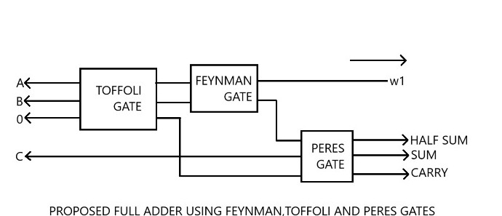
Full Adder implementation using reversible gates:

Slide 13
Drawbacks in existing system:
1. Higher Circuit Complexity:
Existing systems using reversible gates often require more gates to perform the same functions as traditional adders. This increases circuit complexity and can make the design harder to implement and optimize.
2. Slow Execution Speed:
The use of reversible gates can result in longer propagation delays, leading to slower execution times for adders. This could be detrimental for applications requiring high-speed arithmetic operations.
3. Debugging and Testing Issues:
Debugging and verifying the correctness of reversible logic circuits can be more challenging compared to conventional logic due to the inherent complexity and the need to track information flow.
4. Poor Scalability:
As the size and complexity of the adder circuit grow, maintaining an efficient design becomes harder. Larger systems built with reversible gates might face issues in scalability, affecting performance and practicality.

Slide 14
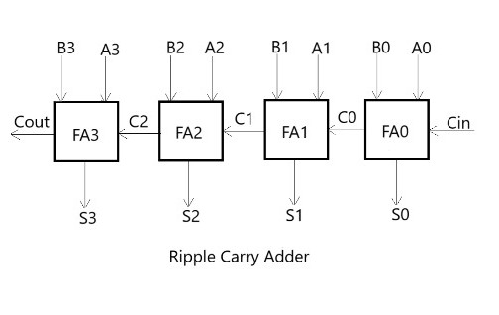
Ripple Carry Adder:
The Ripple Carry Adder(RCA) is one of the simplest and
most widely used adder design in digital electronics. It is a
straight forward digital adder that computes the sum of two
binary numbers It consists of a series of full Adders (FA)
connecting Sequence, with the carry output from Each adder
rippling into the next. The RCA is simple and consumes
Power in low-speed operations, it’s power efficiency Can
be affected by the carry propagation delay. The DCA’S
Simplicity makes it an area-efficient adder for Small-scale
operations, particularly addition, by addressing the limitations
of traditional Ripple Carry Adders (RCA).

Slide 15
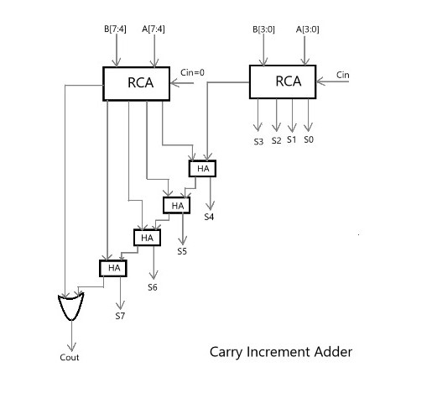
Carry Increment Adder:
The Carry increment-Adder (CIA) is a type of digital adder
that aims to improve upon the traditional Ripple carry-Adder
(RCA) by providing a more Efficient way of handling
carry relatively Propagation. Propagation. The Th CIA has
relatively when compared to low Complexity more advanced
adders like the CLA or CSA. The power Consumption in the
carry increment Adder can be more efficient than the RCA
and suited for applications where moderate-speed additions
are required.

Slide 16
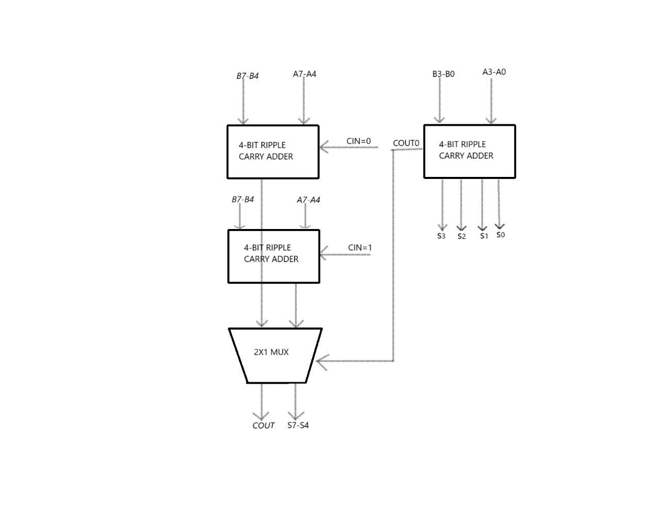
Carry select adder:
The Carry Select-Adder (CSA) is a high-speed digital adder,
architecture used in various computing systems, particularly
where speed is a critical factor, such as in high-performance
processors and digital signal processors (DSPs). The CSA
is designed to speed up the addition of binary numbers by
reducing the time it takes to propagate carry bits. The Carry
Select Adder is generally more power-Efficient than a ripple
carry adder for large operand widths.

Slide 17
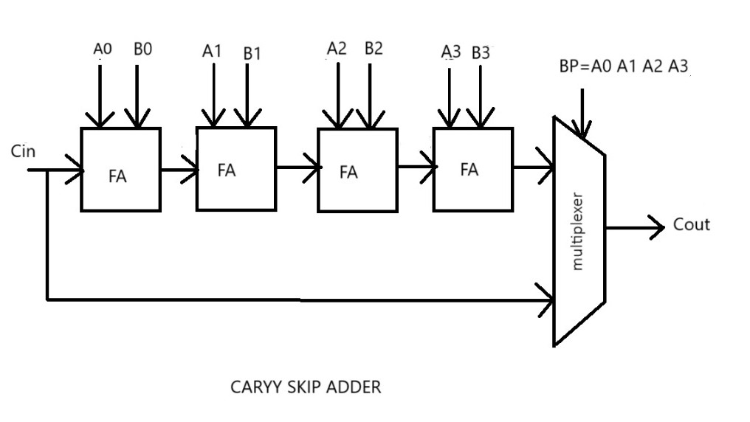
Carry skip adder:
The carry skip Adder (CSA) is a fast and efficient typeof digital adder designed to improve the speed of arithmetic operations, particularly addition, by addressing the limitations of traditional Ripple Carry Adders (RCA). The power consumption of the CSA is generally lower that that of the RCA due to its ability to skip over blocks where carrier do not, propagate. It is commonly used in general-purpose processors, digital signal processors (DSPs) and embedded systems.

Slide 18
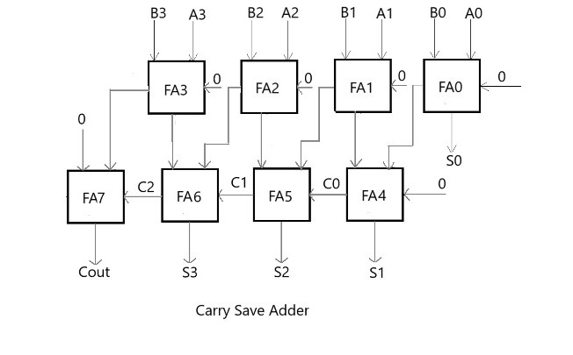
Carry save adder:
The carry Save Adder (CSA) is A Widely used in digital
adder architecture designed to Efficiently handle multi-operand
addition, especially in applications such as multiplication
and multi-operand arithamatic operations. One of the most
significant advantages of the carry save adder is its speed in
addition to speed, the CSA is also quite power efficient.The CSA tends to consume less power than traditional adders in
applications requiring the addition of multiple operands.

Slide 19
Proposed Methodology:
1. Selection of Reversible Gates:
Choose appropriate reversible gates (e.g., Toffoli, Feyman gates) that are suitable for implementing basic logic functions required for addition.
2. Design of Adder Circuits:
Design basic adder circuits (such as Full Adder, Half Adder, or Ripple Carry Adder) using reversible gates.
Ensure that each circuit maintains the reversibility property, meaning no information is lost during computation.
3. Circuit Optimization:
Optimize the designs by minimizing the number of gates and layers to reduce circuit complexity and power consumption.
Use techniques like gate decomposition and circuit transformation to improve the efficiency of the adder designs.

Slide 20
4. Analysis:
After the design phase, the next step is to analyze the performance of the adder circuits. This includes:
Power consumption: Since reversible logic gates are energy-efficient, you would compare the power usage of traditional adders and reversible adder designs.
Speed/Delay: Measure the propagation delay or the time taken for the adder to perform the addition.
Hardware Complexity: Analyze the gate count and area requirements for the design.
Comparison with traditional adders: Evaluate the performance of reversible adders against conventional CMOS adders.
5. Simulation and Testing:
Finally, you would simulate the designs to verify correctness, ensure functionality, and evaluate the overall performance of the adders using tools like Verilog for hardware description and modelsim or xilinx for circuit simulation.

Slide 21
Advantages of proposed Model:
1. Low Power Consumption:
Key Advantage: One of the most significant benefits of reversible logic is the reduction in power consumption. In traditional digital circuits, energy is dissipated as heat due to the loss of information in gates. Reversible gates, on the other hand, do not lose any information, meaning they consume less energy, especially when designed for quantum computing or low-power applications.
2. Reduced Heat Generation:
Key Advantage: In traditional CMOS circuits, energy loss is mainly due to the irreversible nature of logic gates (e.g., AND, OR, NOT). This leads to heat generation, which in turn can limit performance or require additional cooling systems. Reversible gates do not generate heat as a result of the computation.
3. Minimized Gate Count (Efficiency in Design):
Key Advantage: Reversible gates can be combined in ways that reduce the total number of gates needed for a specific logic function. This can result in more compact circuits with fewer resources, which is often an advantage in hardware design.

Slide 22
Required tools :
1. Hardware Description Languages (HDL):
Verilog or VHDL: These are essential for describing the behavior and structure of digital circuits at a high level. You'll use these languages to write the code for your reversible logic gates and adders.
Usage: To model and simulate the circuits, write the logic for reversible gates, and describe the design of different types of adders.
2. Simulation Tools:
ModelSim: A widely-used HDL simulator, especially for Verilog and VHDL. It allows you to test and simulate the functionality of your designed adders using reversible gates.
Xilinx ISE: These are FPGA design tools that support simulation, synthesis, and implementation of circuits. They are useful if you want to test the hardware on FPGA boards.

Slide 23
Result:
This project provides a comprehensive examination of the simulation outcomes, which have been executed (or) synthesized using the XILINX-ISE software and simulated using MODELSIM.

Slide 24
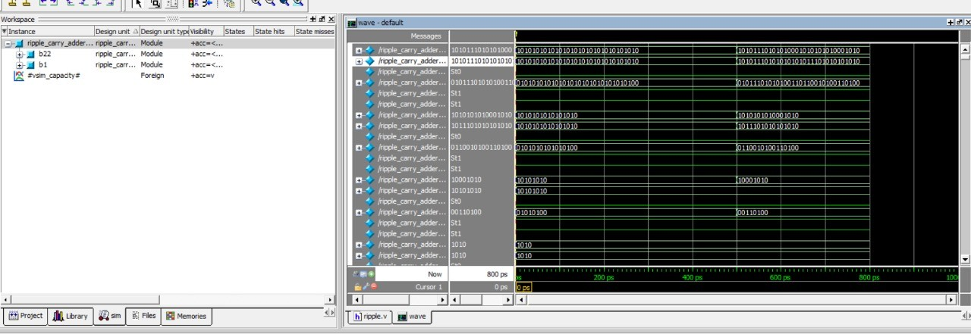
Partial Output:
Ripple Carry Adder

Slide 25
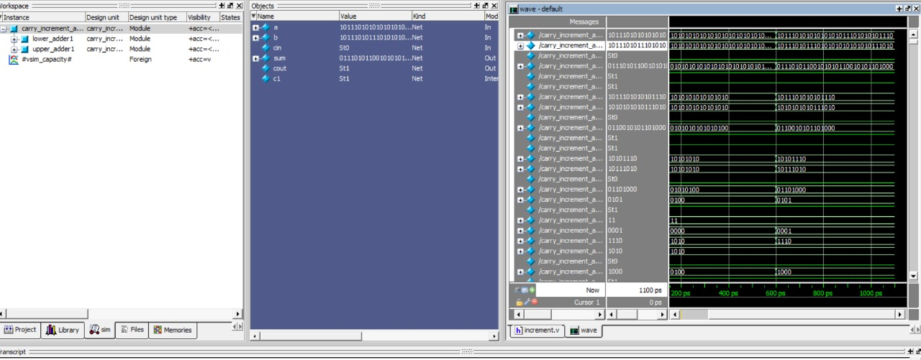
Carry Increment Adder:

Slide 26
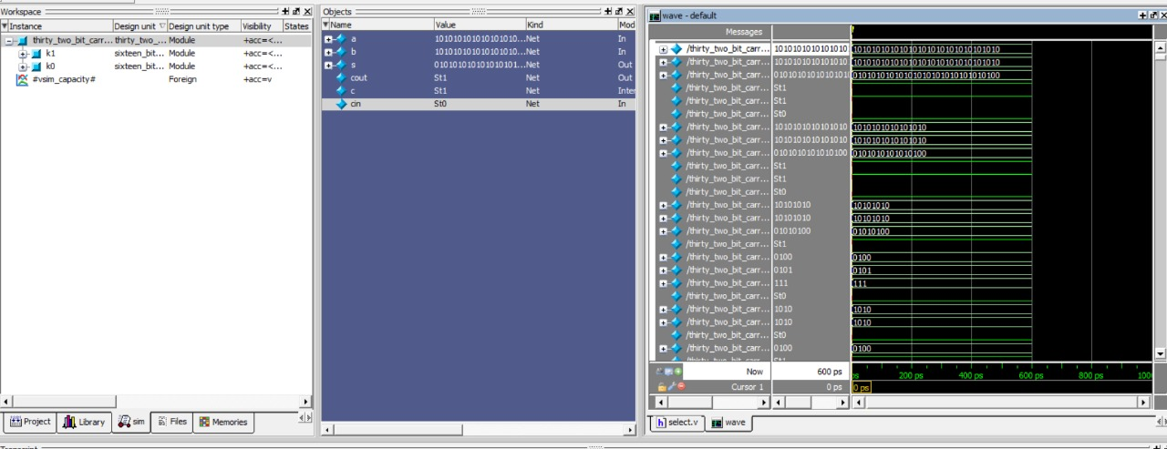
Carry select adder:

Slide 27
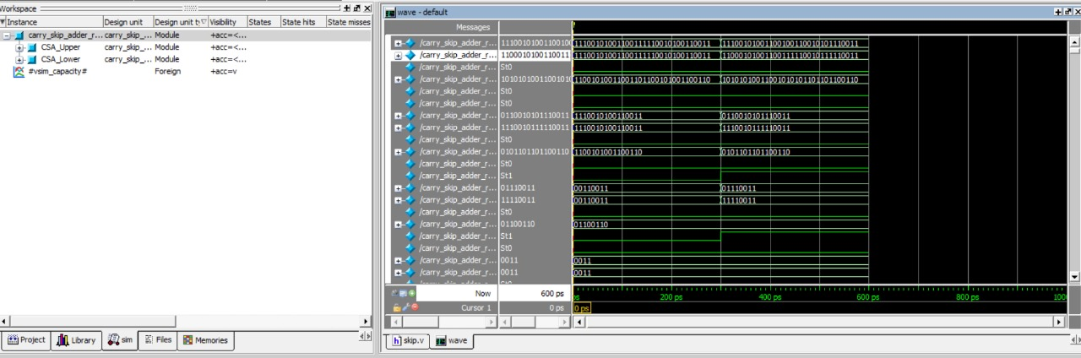
Carry skip adder:

Slide 28
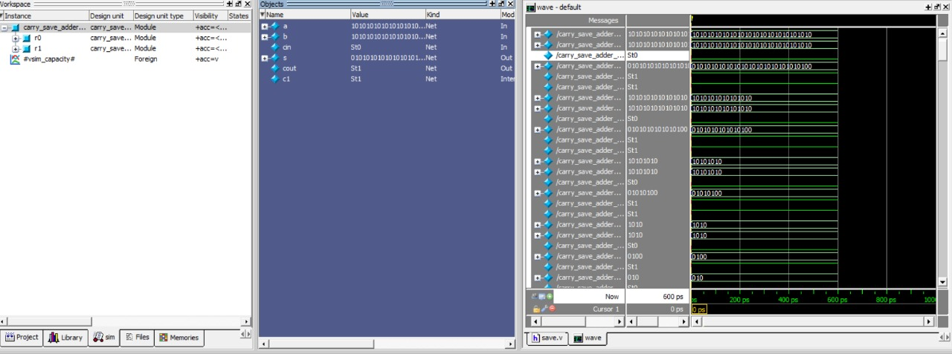
Carry save adder:

Slide 29
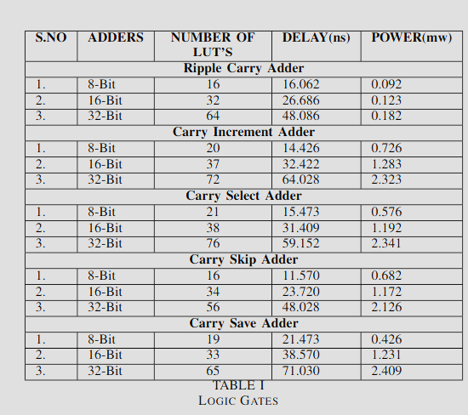
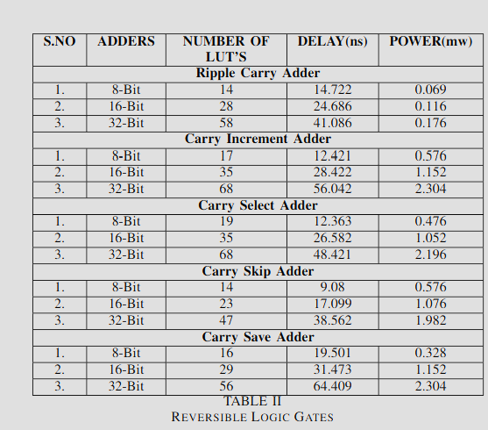
Comparison of Delay & Power :

Slide 30
References:
[1] ”High-Speed Vedic Mathematics: Multiplication Made Faster” by Tirthaji Maharaj and V. S. Agrawala
[2] ”Vedic Mathematics for Schools, Book 1” by James T. Glover.
[3] ”Vedic Mathematics Made Easy” by Dhaval Bathia.
[4] ”Vedic Mathematics” by Sri Bharati Krsna Tirthaji.
[5] Noorallahzadeh, Mojtaba, et al. ”A new design of parity preserving reversible Vedic multiplier targeting emerging quantum circuits.” Inter national Journal of Numerical Modelling: Electronic Networks, Devices and Fields (2023): e3089.
[6] Verma, Aishita, Anum Khan, and Subodh Wairya. ”Design and Analysis of Efficient Vedic Multiplier for Fast Computing Applications.” Interna tional Journal of Computing and Digital Systems 13.1 (2023): 190-201.

Slide 31
Thank you

